Slide 1
TECH SUPPORT
PASSWORD RESET
End Users reset passwords

Slide 2
SCOPE OF WORK
comEMR SUPPORT TEAM & THEIR SCOPES
LEVEL#1
RESOLVING GROUP
Chiefdom Supervisors
District ICT
LABS Capacity building champions
Medtronic LABS Support
Mixed expertise based on issue raised
Regional ICT
LABS Ops Leads
ToTs
LEVEL#2
CHAMPIONS
END USER/HCPS
CHW
Peer Supervisor
CHC Staff
CHP Staff
MCHP Staff
comEMR User Password Reset
comEMR User Password Update
Report issue to comEMR Facility Admin
Issue reporting through the support feature.
Handle all tickets escalated by L1 team
User Management
Facility account management
Data Logic
Data extraction
Field device basic troubleshooting
Design and develop enhancement requests.
Provide oversight for support and release management.
Last line of support for all issues coming from the end-users
comEMR User Account Management
Data logic related queries
Assistance in App deployment
Device Level Basic Troubleshooting (Data connection, OS errors, etc.)
Design sign-off
Notes:
This slide breaks down the scope of work for the comEMR Support Team across four levels.
Begin with Level 1, which is the first line of support dealing with user account issues, basic data logic queries, and initial troubleshooting.
Level 2 takes over escalated tickets, managing user and facility accounts, and more advanced troubleshooting.
Level 3 involves the global tech and design teams that handle escalated issues, manage device and app prioritization, SMS portal administration and oversee new feature rollouts.
Finally, Level 4 encompasses the development team, data scientists, and product managers who work on escalated issues from Level 3, handle the SPICE app releases, and are responsible for training and development. Emphasize the importance of each level's distinct roles and the collaborative effort to provide comprehensive support for SPICE users

Slide 3
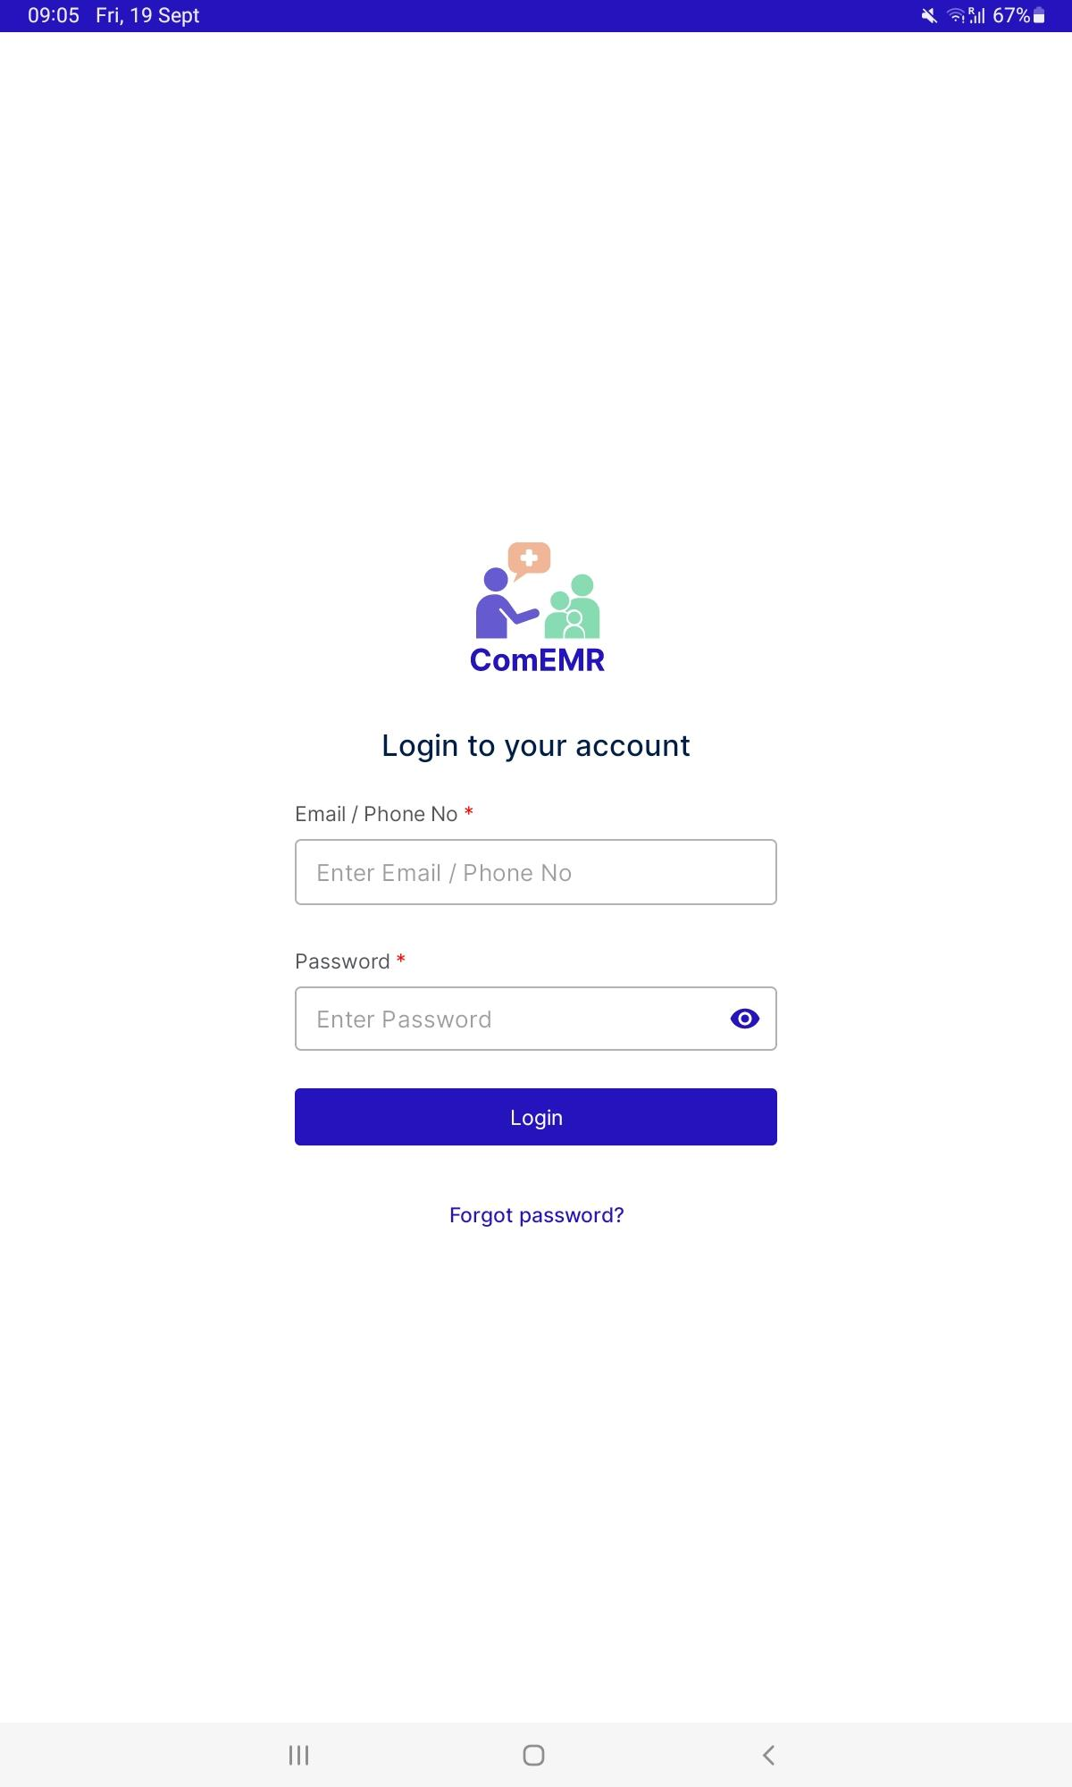
Step 1 :
When you open comEMR App, Click on forget Password

Slide 4
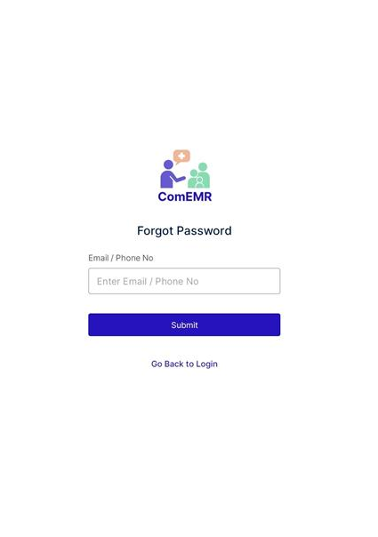
Step 2 :
Enter your phone number you submitted for registration on comEMR
Step 3 :
Click on Submit

Slide 5
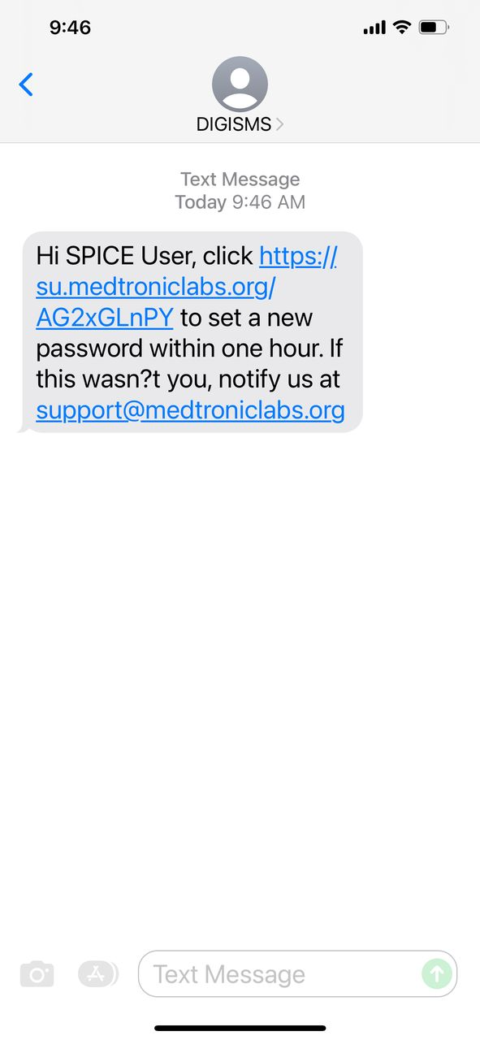
Step 4 :
You will Receive this SMS on your phone ,click on the link provided as shown:

Slide 6

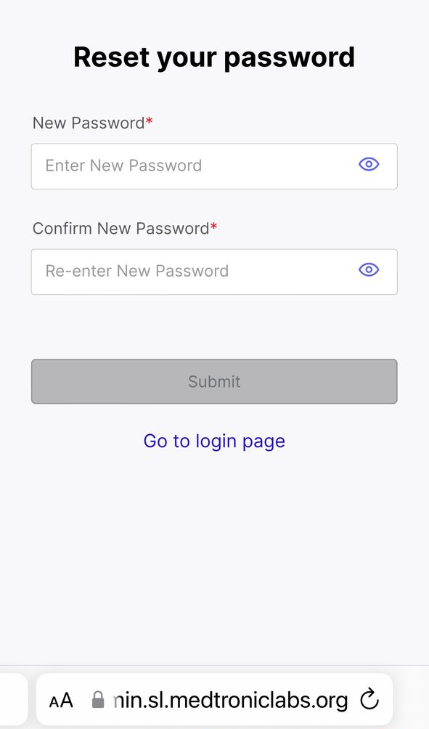
Step 5 :
You will land on the screen shown ,enter your preferred password and confirm the password
NB:The password must Start with an uppercase letter, then lower case followed by numbers.
Eg Jam332

Slide 7
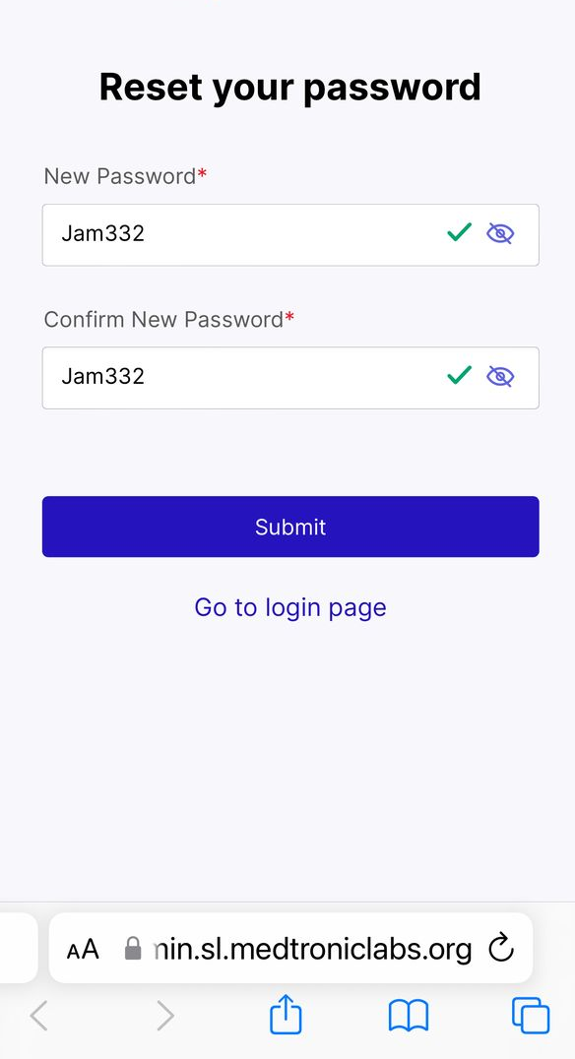
Step 6 :
Once you have entered your preferred password,click on the submit button and your password will be updated.

Slide 8
Q & A

